Slide 1

CYBER SECURITY
ESIREDDY VINAY KUMAR REDDY
KALLAM HARANADTHREDDY INSTITUIN OF TECHNOLOGY
B.TECH FINAL YEAR
ROLL NO : 208X1A1257

Slide 2



Definition of Cybersecurity and Ethical Hacking
Cybersecurity
Ethical Hacking
Cybersecurity is the use of technologies, processes, and practices to protect devices, networks, data, and programs from attack, damage, or unauthorized access. It's also known as information technology security.
Ethical hacking is a process that involves trying to access a computer system, application, or data without authorization. Ethical hackers use the same tools and techniques as criminal hackers, but with permission from the owner of the system

Slide 3
Stages of Ethical Hacking!
1. Reconnaissance
2. Scanning
3. Gaining Access
4. Maintaining Access
5. Clearing Track
or
Covering Track

Slide 4
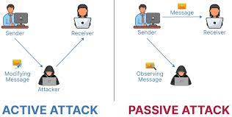
Attacks in Cybersecurity
1. Active Attack :
An active attack is a type of attack in which hackers modify the information or the data.
2. Passive Attack :
In contrast, a passive attack is an attack in which hackers do not modify the information or the data.

Slide 5
Types in Attack
Active Attacks Types :
- Man in the Middle
- Snoffing
- Phising
Passive Attacks Types :
- Traffic Analysis
- Release of Message Contents

Slide 6
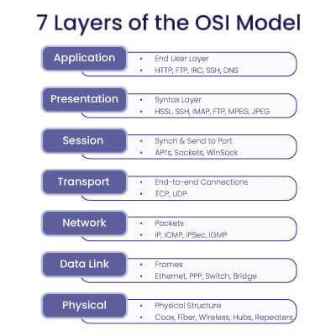
OSI Models
1.The Open Systems Interconnection (OSI) model is a conceptual framework that describes 7 different layers of a network stack combine to enable network communication
2.OSI is a reference model that describes how information from a software application in one computer moves through a physical medium to the software application in another computer

Slide 7
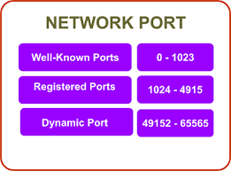
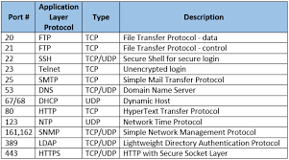
Types of Network Ports and Common Ports

Slide 8
Networking Commands
1. Ifconfig :
A basic networking command that provides information about network interfaces, their state, assigned IP addresses, and counts of packets that have crossed the interface since the system was last booted.
2 . Path ping :
A command that measures the quality of a host-to-host computer network connection. It sends Internet Control Message Protocol (ICMP) echo requests to each pointed-to destination and displays the response time and packet loss for the packets returned from each destination.
3. Nmap :
A staple in cybersecurity and one of the first tools pen testers will use to enumerate networks. It's widely used for network reconnaissance, vulnerability assessment, and security auditing.

Slide 9
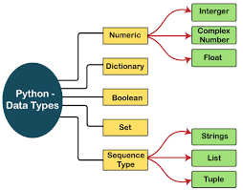
Python data types
Python has five standard data types : Numbers, Strings, Lists, Tuples, and Dictionaries.
1. Numbers can be integers, floats, or complex numbers.
2. Strings are sequences of characters.
3. Lists are ordered collections of objects.
4. Tuples are ordered collections of objects that cannot be changed.
5. Dictionaries are unordered collections of objects that are accessed by key.

Slide 10
Python Control Structures
Python also has a number of control structures that allow you to control the flow of your program. These include:
if statements allow you to execute code if a certain condition is met.
else statements allow you to execute code if a certain condition is not met.
elif statements allow you to execute code if a certain condition is met, but only if a previous condition was not met.
for loops allow you to execute code a certain number of times.
while loops allow you to execute code while a certain condition is met.
break statements allow you to exit a loop early.
continue statements allow you to skip to the next iteration of a loop.

Slide 11
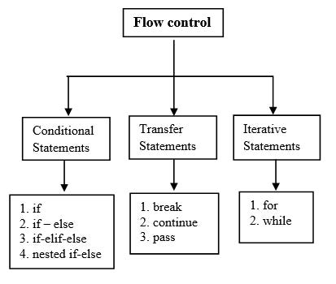

Slide 12
Web Application Security
To protect your Python web applications, you should start with the basics - validate and sanitize all user inputs to protect against SQL injection and XSS attacks. You can make use of frameworks like Django or Flask, which come with built-in protection tools. You should also implement HTTPS to secure data in transit

Slide 13
OWASP API Security Risks
1. Excessive data exposure :
The API responds with additional data that the client is expected to ignore or filter. This is the third most critical API security threat.
2. Improper assets management :
The API doesn't track API-related assets throughout their life cycle. Attackers can gain unauthorized access to sensitive data or full server access through old, unpatched, or vulnerable versions of APIs.
3. Broken authentication :
The API's authentication and session management mechanisms have weaknesses. Attackers can compromise user credentials, impersonate legitimate users, gain unauthorized access to sensitive information, or perform malicious actions.
4. Unrestricted resource consumption :
The system doesn't guard against running out of bandwidth, memory, processing power, or other basic resources. This can cause systems to be overwhelmed by too many requests.

Slide 14
5. Insufficient logging and monitoring :
The API doesn't have sufficient logging and monitoring. If it doesn't have missing or ineffective integration with incident response, attackers can take advantage and fully compromise systems.
6. Mass assignment vulnerability :
The application binds client-provided information to its data models without proper filtering based on a whitelist.
7. Unrestricted access to sensitive business flows :
The API exposes sensitive functionality in such a way that it causes harm to the business through automated overuse.
8. Injection :
This can lead to information disclosure and data loss. It can also lead to DoS or complete host takeover

Slide 15
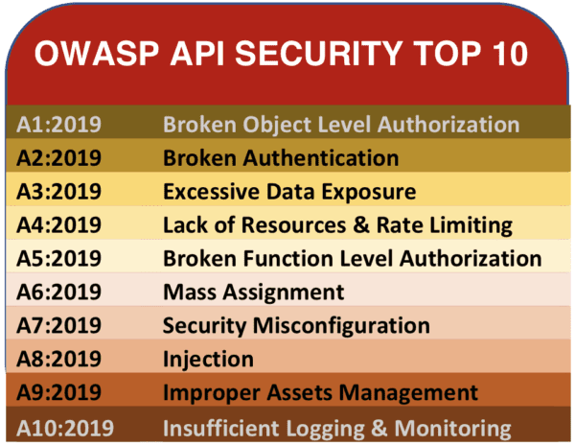

Slide 16


